Slide 1

Airbnb Price Prediction & Analysis
Team 1

Slide 2

Agenda
Business Problem/ Introduce Dataset
Data Cleaning
Show Descriptive Analyses in R
Model & Main Results & Challenges
Conclusion

Slide 3

Imagine you are an House owner…

Slide 4
Project Mission
Use the property and host information to predict a reasonable price.
From Airbnb price prediction dataset

Slide 5
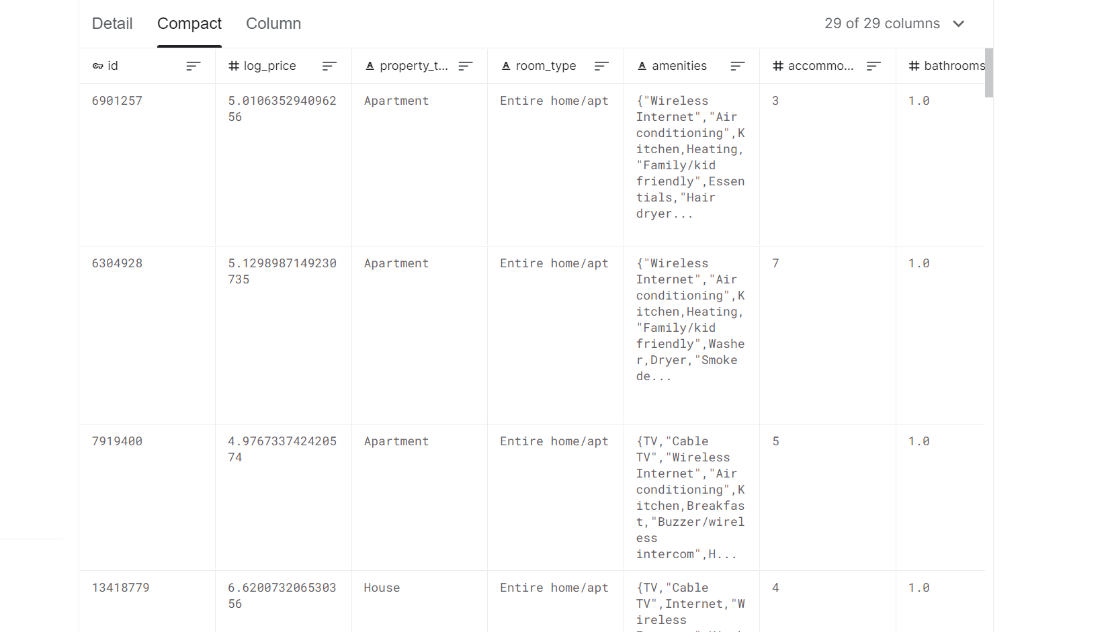
Dataset
Kaggle - Airbnb price prediction (Feb, 2018)
29 columns with Mixture of data types : String/Categorical/Numerice
74k rows

Slide 6
Data Cleaning
Delete: ID, description, zip code, neighborhood,
Deal with missing Data: numerical variables -> impute with mean
categorical ->drop
Create Dummies
Convert to time length: host_since
Clean categorical variable by regex: Amenities
Create Train and Test Dataset
Notes:
First, we droped 4 columns that doesn't or hard to provide predictability, including ID, description, zipcode, and neighborhood then we start to focus on cleaning data, for missing numerical variables, we impute with mean , for missing categorical variables, we just drop it. then we Create Dummies and convert host_since columns to time length to better help our analyze.
Convert to time length: host_since Because kaggle doesn’t provide us test dataset, we have to make our own test data from the original one. And we did this when we built our model. Next, I will introduce Kexi to present you some interesting fact we found while we exploring the data.

Slide 7
Descriptive Analyses
Three Dimensions:
Single variable plot- distribution of the predicted variable
Two-variable plot - rough relationship plot
Three- variable plot- with a hue

Slide 8
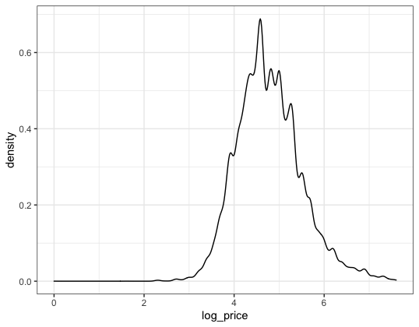
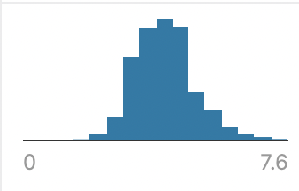
Descriptive Analyses
Single Variable - the Predicted Variable
4.62
Central range: [3, 7]
= Price range: [20.08, 1998.19]
Highest density: 4.62 (about 70%)
= Price: 101.49

Slide 9
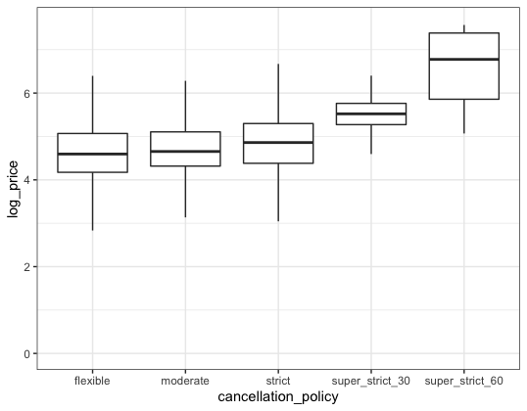
Descriptive Analyses
Two-variable plot - the predicted variable with one predictor (simple)
Assumption: positive relationship: stricter policy - higher price
Result: positive relationship
Median
Range between the 25th and 75th percentile
Outliers are omitted in this case

Slide 10
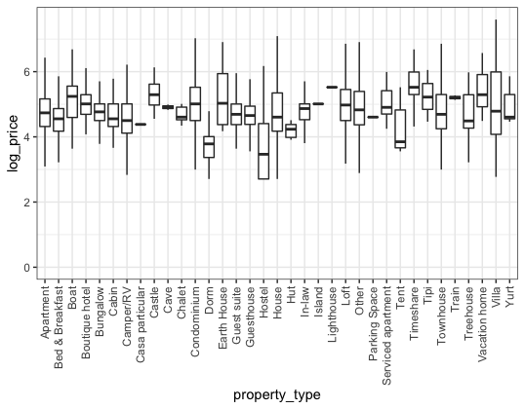
Descriptive Analyses
Two-variable plot - the predicted variable with one predictor (complicated)
Log price and property types
Highest median：Tent and lighthouse
Assumed reason: High cost
Interesting finding:
Cave and island

Slide 11
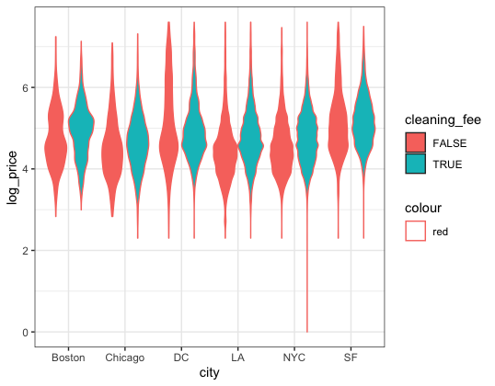
Descriptive Analyses
Three-variable plot - the predicted variable with two predictors (hue added)
Mean and median are not enough
The distribution of log price with more variables
Cleaning fee: higher log price
Similar ranges but different distributions
Fatter tails for DC and SF

Slide 12
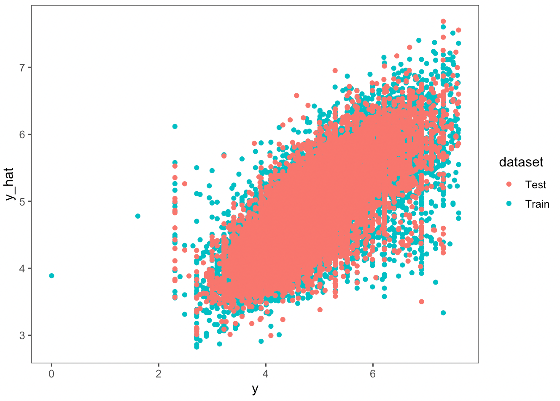
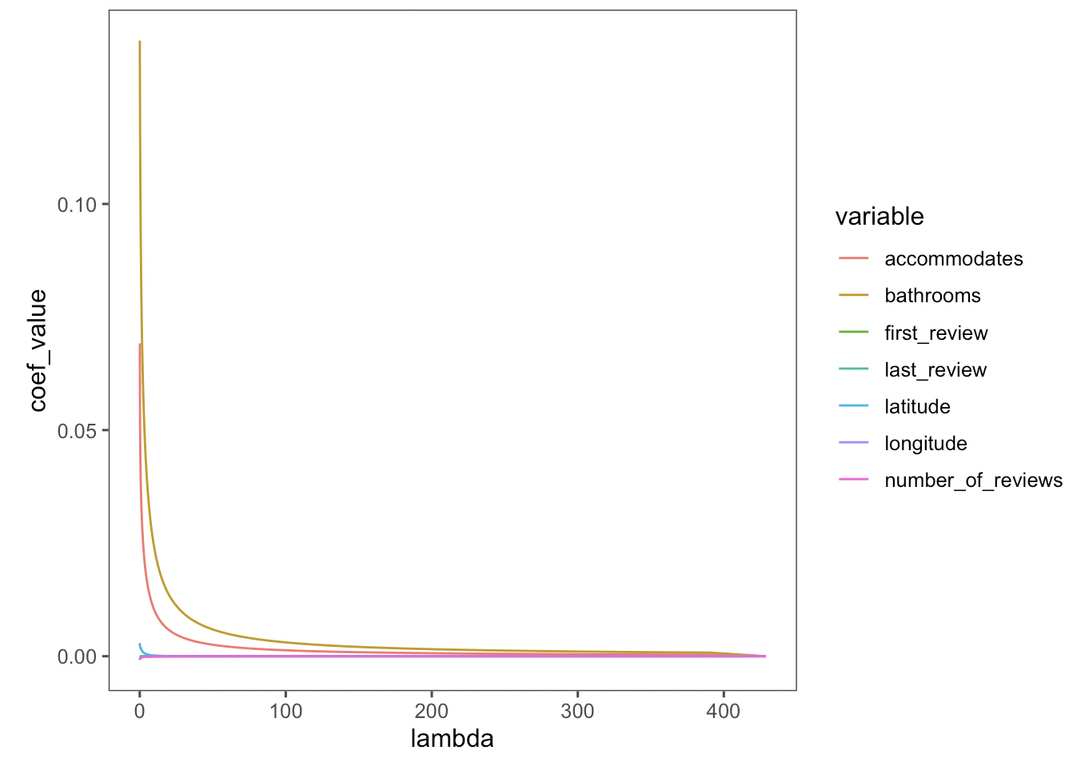
Main Results
Linear Regression
Ridge Regression
MSE Train: 0.2072
MSE Train: 0.2173
MSE Test: 0.2109
MSE Test: 0.2170

Slide 13
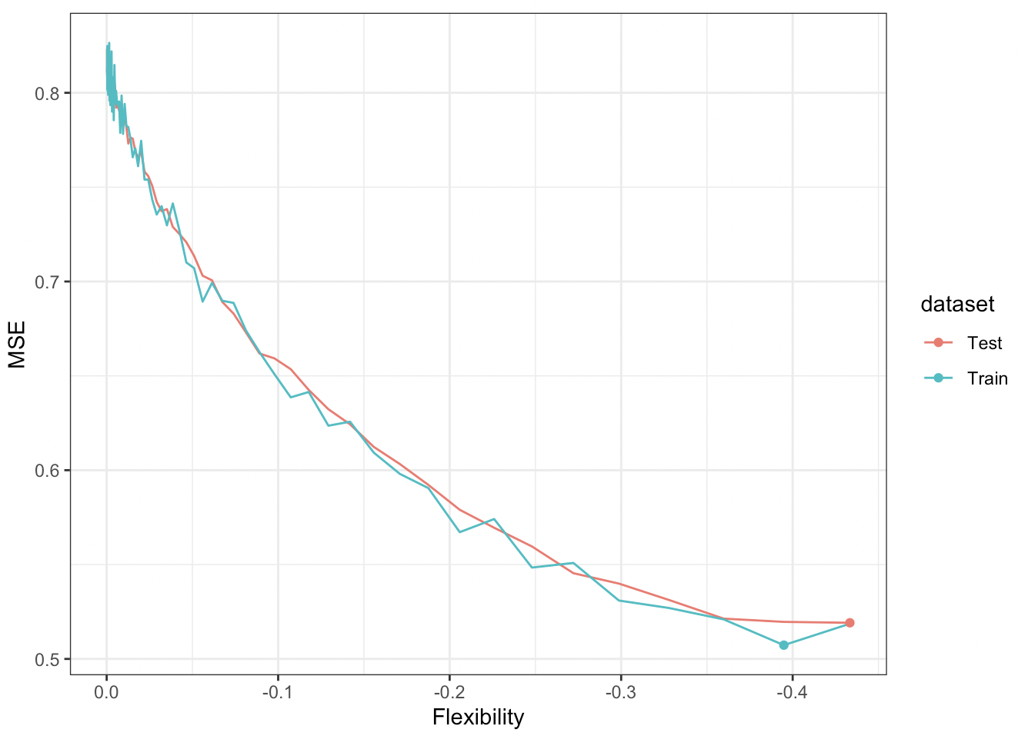
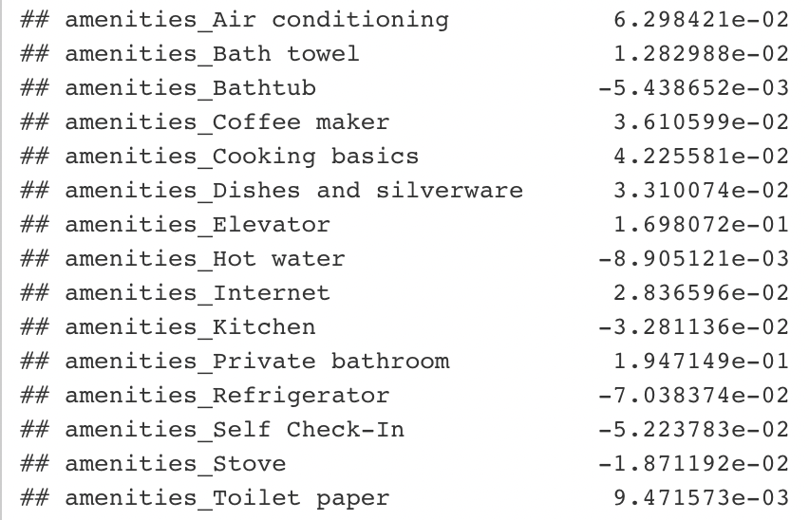
Main Results II
Lasso
Challenge
MSE Train: 0.3948
MSE Test: 0.4333
Some of coefficients can not be explained

Slide 14
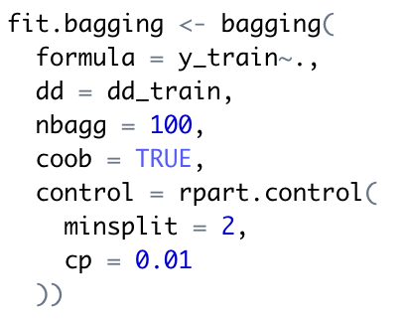
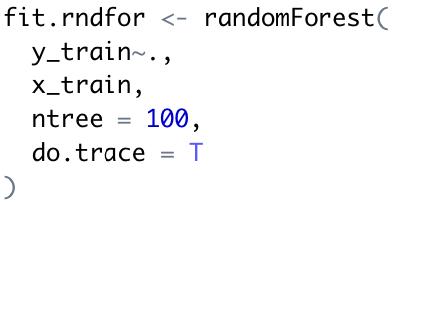
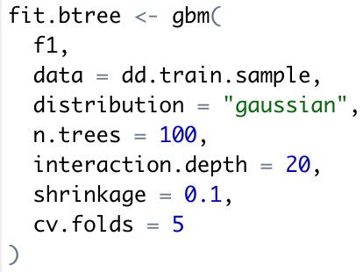
Main Results III
Bagging
Random Forests
Boosting
MSE Train: 0.2510
MSE Train: 0.0305
MSE Train: 0.1802
MSE Test: 0.2536
MSE Test: 0.1541
MSE Test: 0.1850
Notes:
Challenges: inference to convince people

Slide 15
Boosting
n.trees = 100, interaction.depth = 1, shrinkage = 0.001, mse_train: 0.4796789; mse_test: 0.48406
n.trees = 100, interaction.depth = 1, shrinkage = 0.01, mse_train: 0.3406027; mse_test: 0.3454715
n.trees = 100, interaction.depth = 1, shrinkage = 0.1, mse_train: 0.2251666; mse_test: 0.2283994
n.trees = 100, interaction.depth = 2, shrinkage = 0.001, mse_train: 0.4711037; mse_test: 0.4750863
n.trees = 100, interaction.depth = 2, shrinkage = 0.01, mse_train: 0.3064798; mse_test: 0.3099995
n.trees = 100, interaction.depth = 2, shrinkage = 0.1, mse_train: 0.1902003; mse_test: 0.194123
n.trees = 100, interaction.depth = 3, shrinkage = 0.001, mse_train: 0.4696736; mse_test: 0.4735253
n.trees = 100, interaction.depth = 3, shrinkage = 0.01, mse_train: 0.2963097; mse_test: 0.299599
n.trees = 100, interaction.depth = 3, shrinkage = 0.1, mse_train: 0.1802872; mse_test: 0.1850507
Notes:
Interaction.depth = 1 : additive model, interaction.depth = 2 : two-way interactions

Slide 16

Challenges
Find the best parameters
Interpret the results

Slide 17
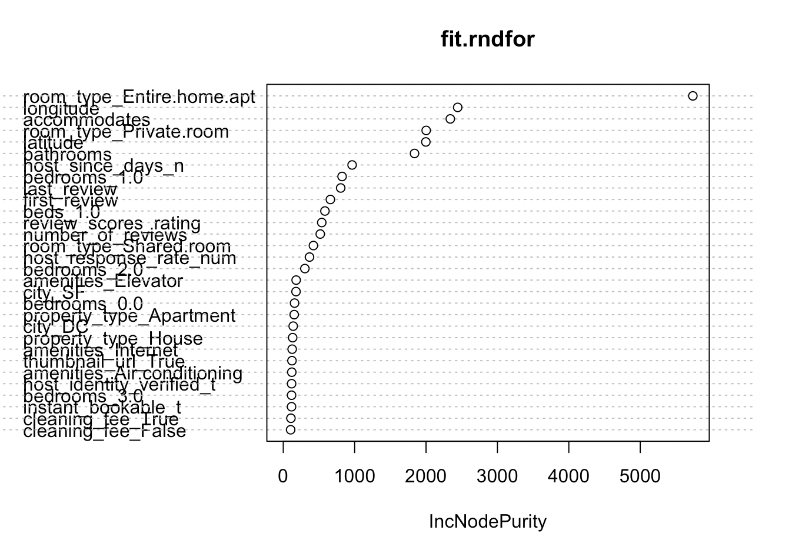
Conclusion
Among all models, Random Forest outputs the best mse for both training and testing.
Variables most important plotted.
Notes:
Hi, I'll be talking about our conclusion for the project. Among all models we tried, Random Forest had the best MSE for both training and testing.
For feature selection of the Random Forest, as we plotted on the right, we believe variables like having an entire Home or Apartment for room type effects the listing price the most with other variables like beds and bathrooms.

Slide 18

Conclusion
Most Important Variables
Accommodates
Bathrooms
Beds
Room type:
Positive: Entire home/apt, Private room
Negative: Tent, Hostel, Shared room, Dorm
Amenities: Private bathroom, Internet, Elevator
Bed type:
Positive: Couch, Real Bed, Sofa
Negative: Airbed, Futon
Notes:
For other models such as linear, lasso, and ridge, we observed a pattern that the accommodates, bathrooms, and beds have a huge positive impact on the price. In addition to room type is while entire places have a positive correlation, room types like tents, hostels, shared rooms have negative impacts.
Moreover, Bed types play a big role in the results. Higher-priced Airbnbs are more likely to include real beds, sofas, or couches distinguishing from Airbnbs with airbeds and futons, which are close to sleeping on the ground.
From our models, we can calculate a reasonable price of an Airbnb with given predictors. Owners can also benefit to position themselves in the market.
We are team one. Thank you everyone for listening. We'll be open for Q&As now.

Slide 19
Q & A

